Slide 1
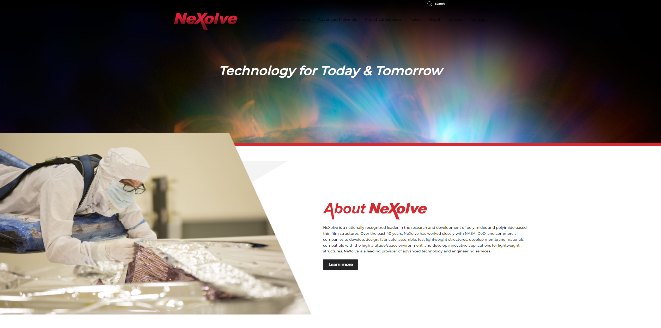
Learn more about opportunities with our innovative, dynamic and growing company on our website www.NexXolve.com

Slide 2
High Performance Products, Advanced Materials
Jim Moore
Jim.Moore@nexolve.com
290 Dunlop Blvd, Building 200
Huntsville, AL 35824
www.nexolve.com

Slide 3
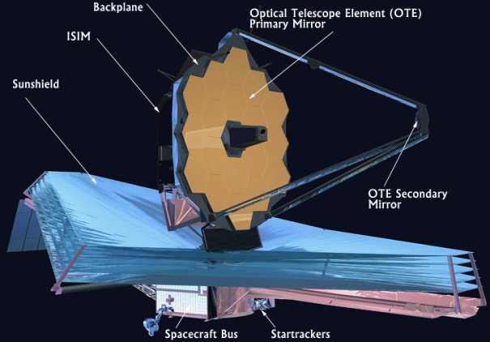
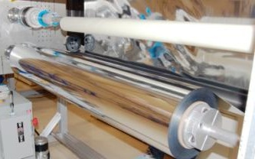
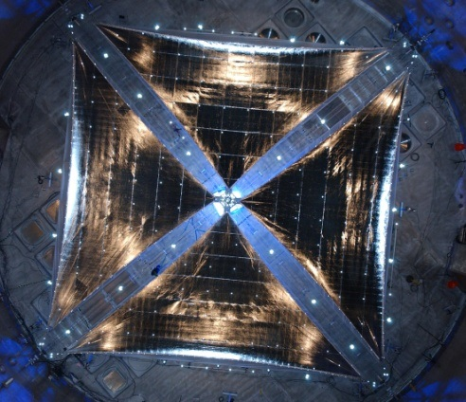
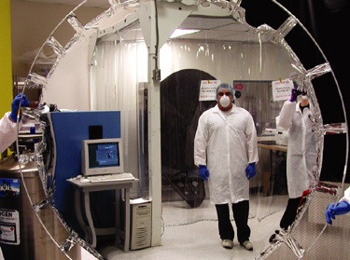
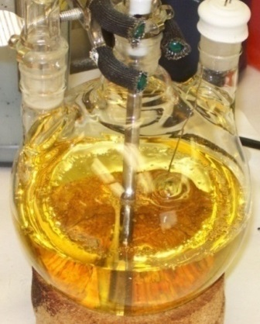
NeXolve
NeXolve Holding Company – Jim Moore CEO
  Huntsville, AL
  Small Business Incorporated in 2017
  Multiple Team Members with 30 Plus Years of Experience
Aerospace Products – Director: Jim Pearson
  Engineering Services
    Design and Modeling
  Aerospace Products
    Solar Cruiser Solar Sail
    James Webb Space Telescope sunshield.
    Small spacecraft deployable systems
    MLI and lightweight systems
    Thin-film photovoltaics
Advanced Materials – Director: Brandon Farmer
  Spacecraft Products
    Optical Quality Membranes
  Polymer Products
    Films, Resins, Powders
  Analytical Services
    Characterization and Analysis

Slide 4
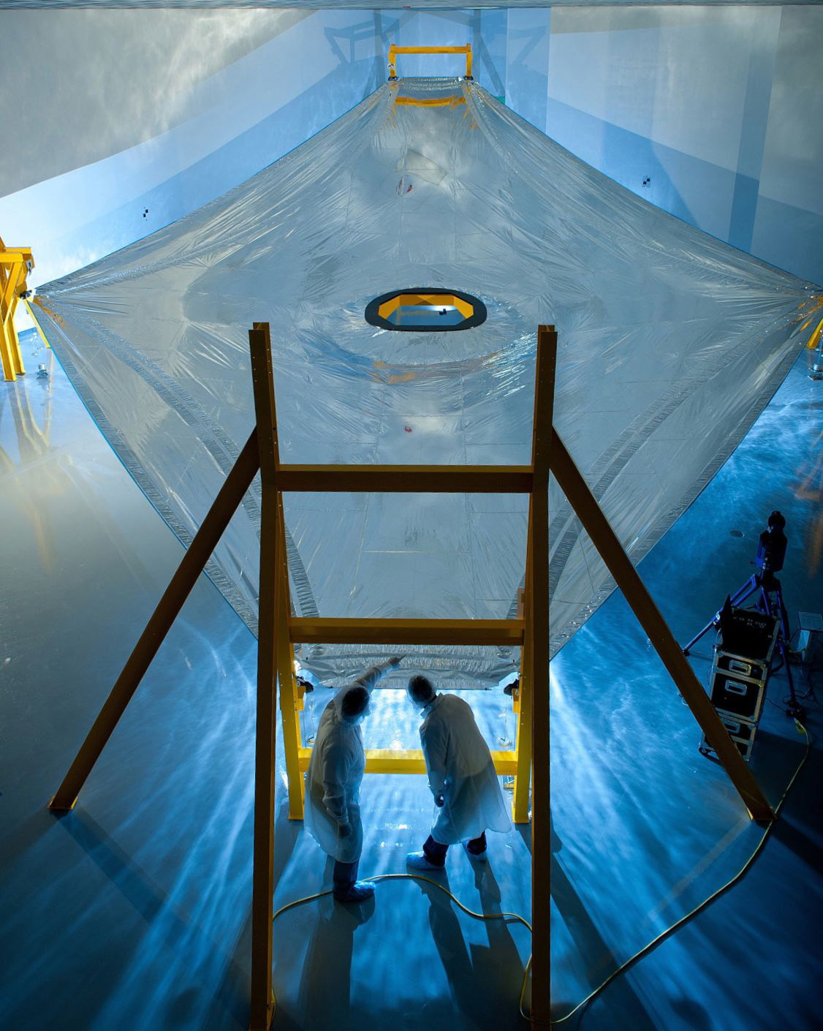
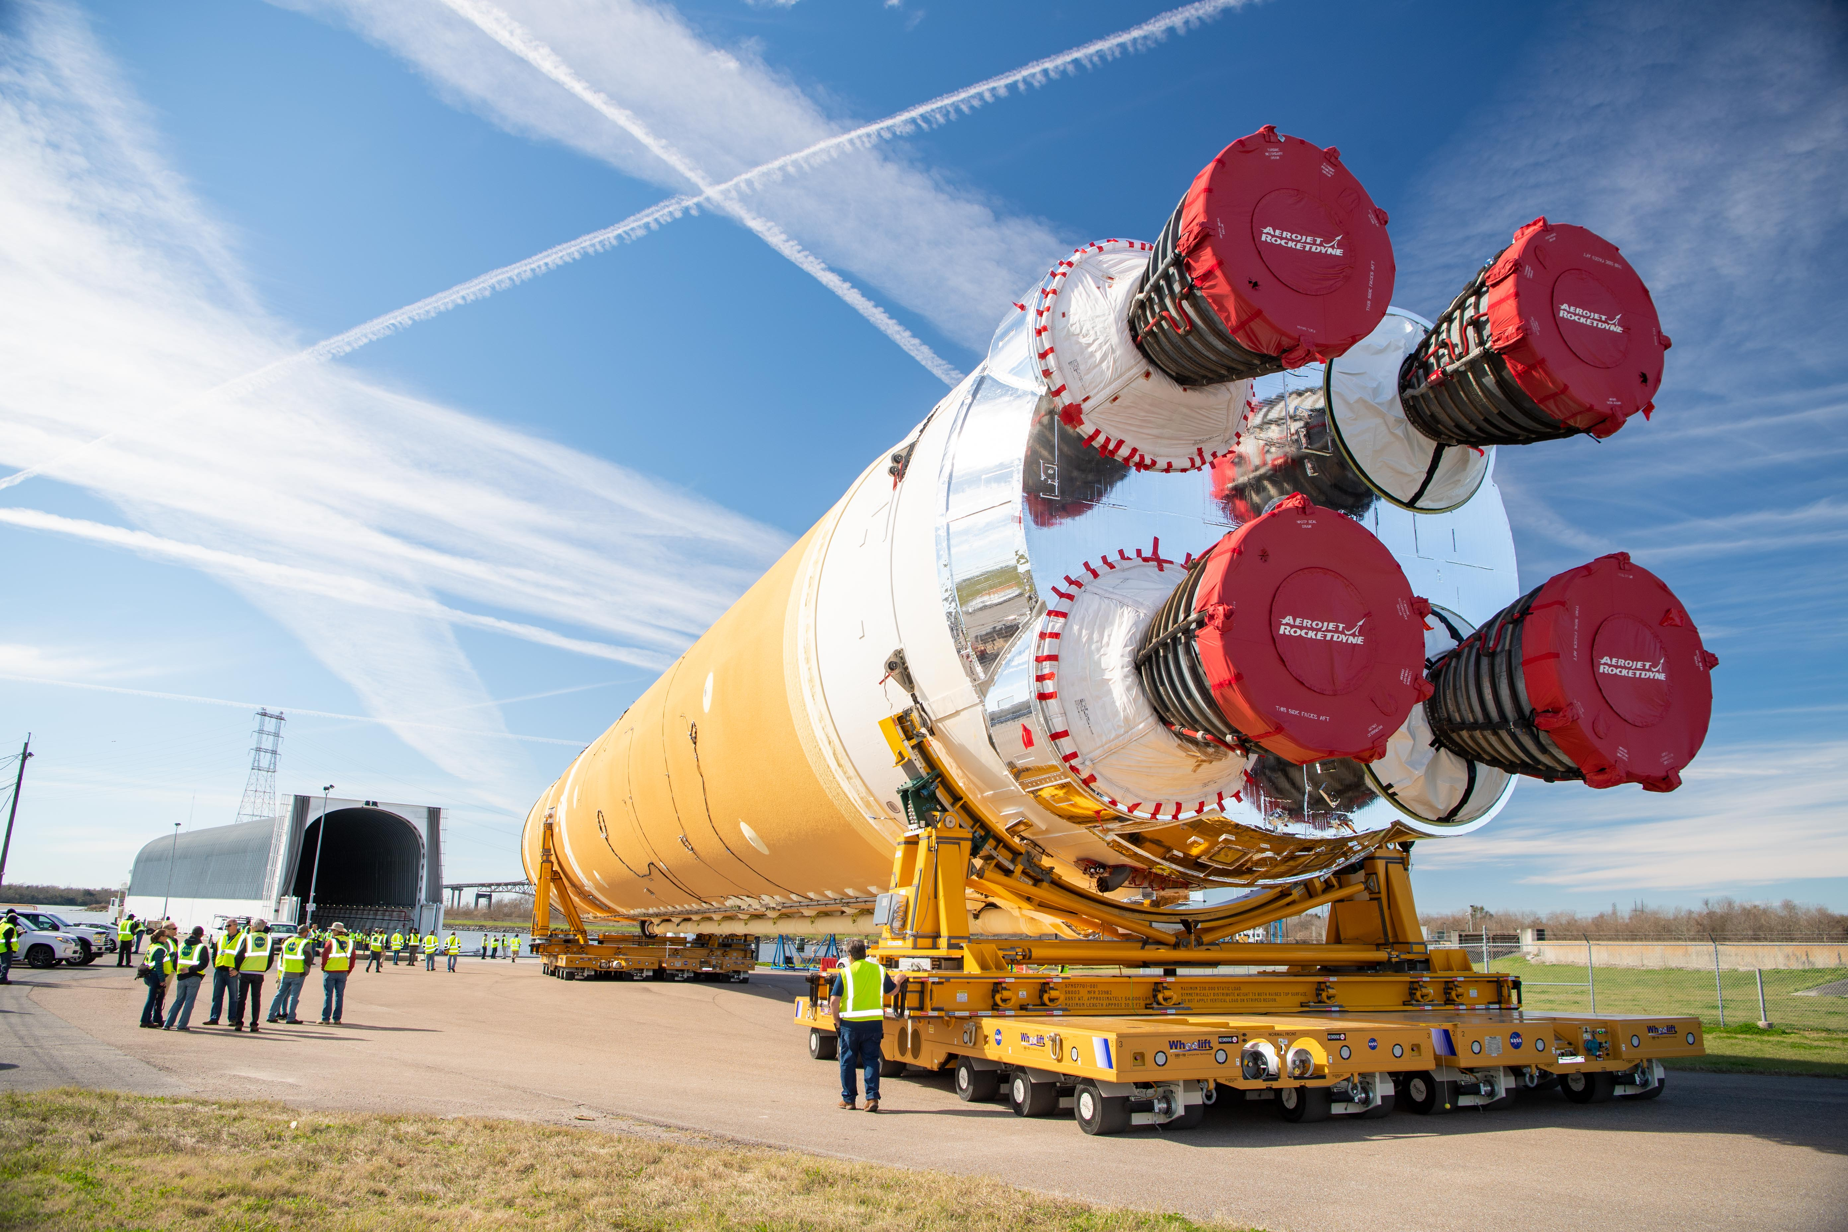
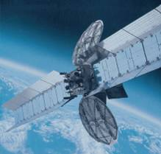
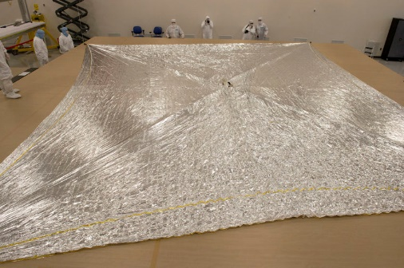
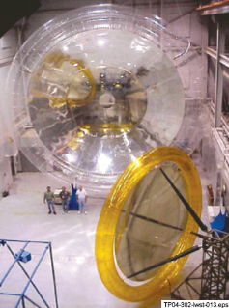
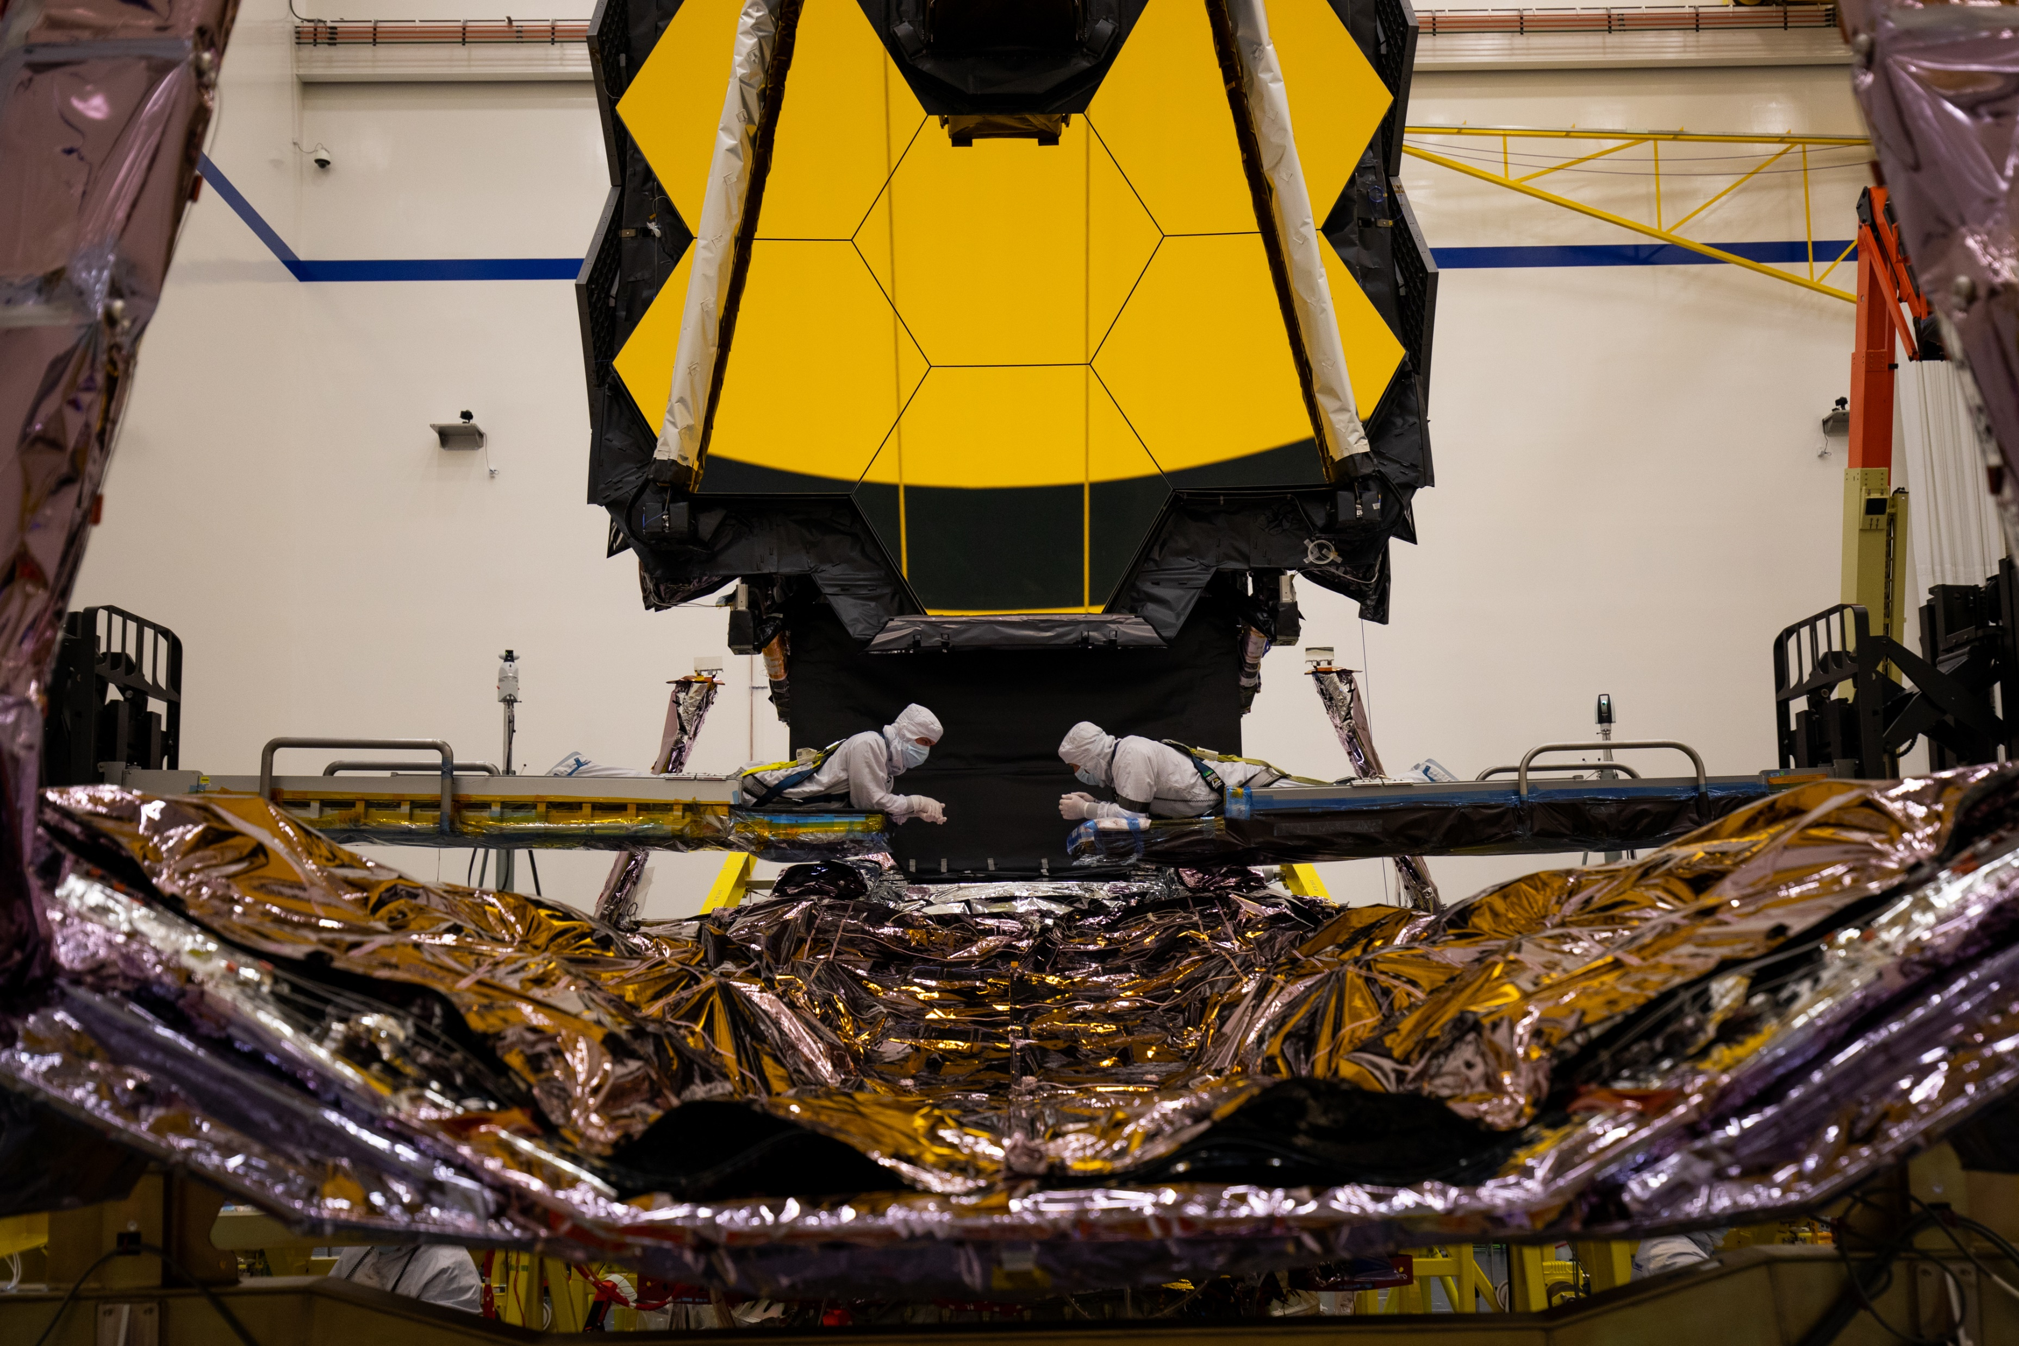
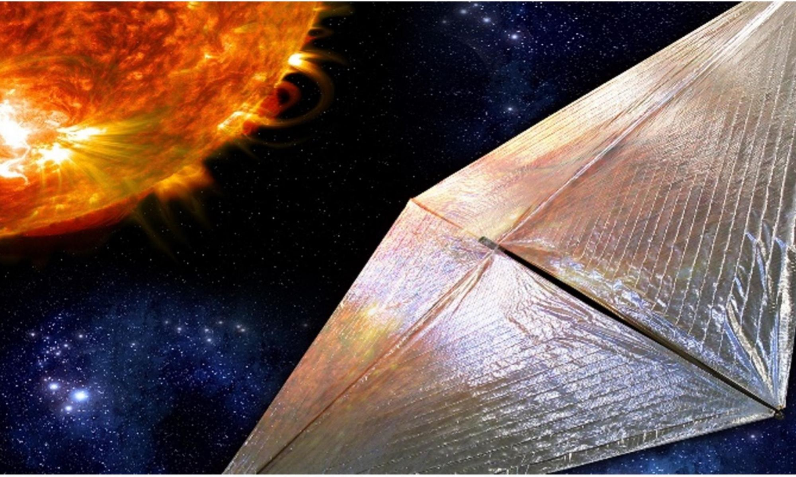
Aerospace Products
Engineering Heritage
  Thin Film Materials and Control of Materials
  Leader in Thin Film Polymer Material Design and Manufacturing
    Sunshades and Reflectors
    Solar Sail Propulsion
    Deployable antennas and concentrators
    Multilayer Insulation
  Expertise in Modeling and Analysis
  Expertise in Thermal Modeling and Analysis
Spacecraft Flight Heritage
  On-going commercial flight programs
  Nanosail D
  NEAScout
  Solar Cruiser
  NuStar X-ray Telescope
  Space Launch System – Artemis 1
  Key provider to NASA’s JWST program
Engineered Films
Spacecraft Blankets and Sunshields
Inflatable RF Antenna’s and Concentrators
JWST Sunshield Provider
Solar Sails

Slide 5
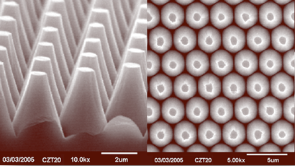
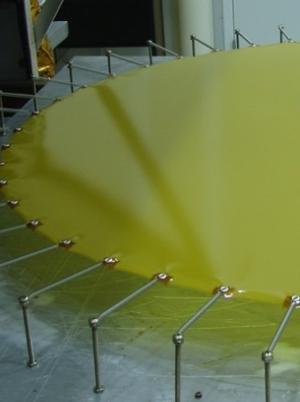
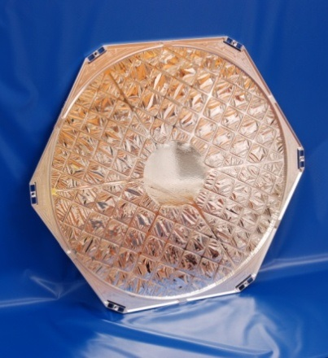
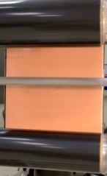
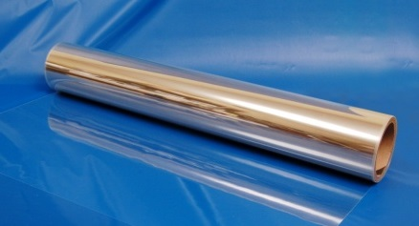
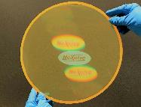
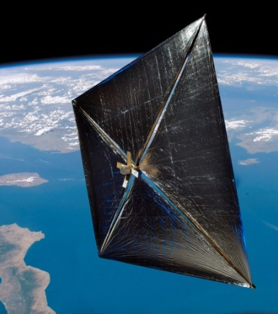
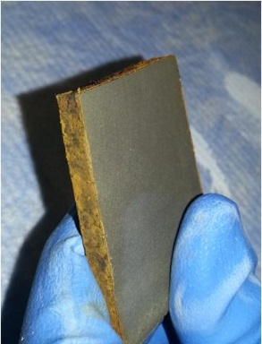
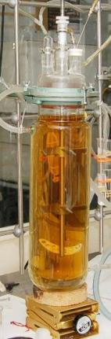
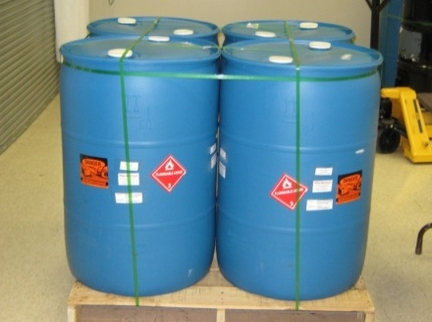
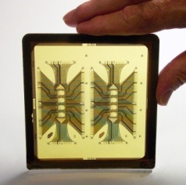
Advanced Materials
We manufacture and develop Advanced Materials for Demanding Applications
Core competencies
  High Temperature Polymers
  CTE matched polyimides
  Micron gauge film manufacturing and handling
  Specialty coatings
  Rapid product development
Products
  Raw powder polymer
  Liquid resin casting or spray polymer solution
  Unfinished polymer film
  Finished polymer film
Markets Served
  Environmental protection
  Wire and cable coatings
  Microelectronics
  Aerospace

Slide 6
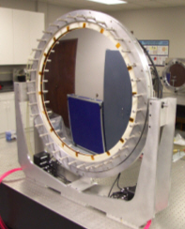
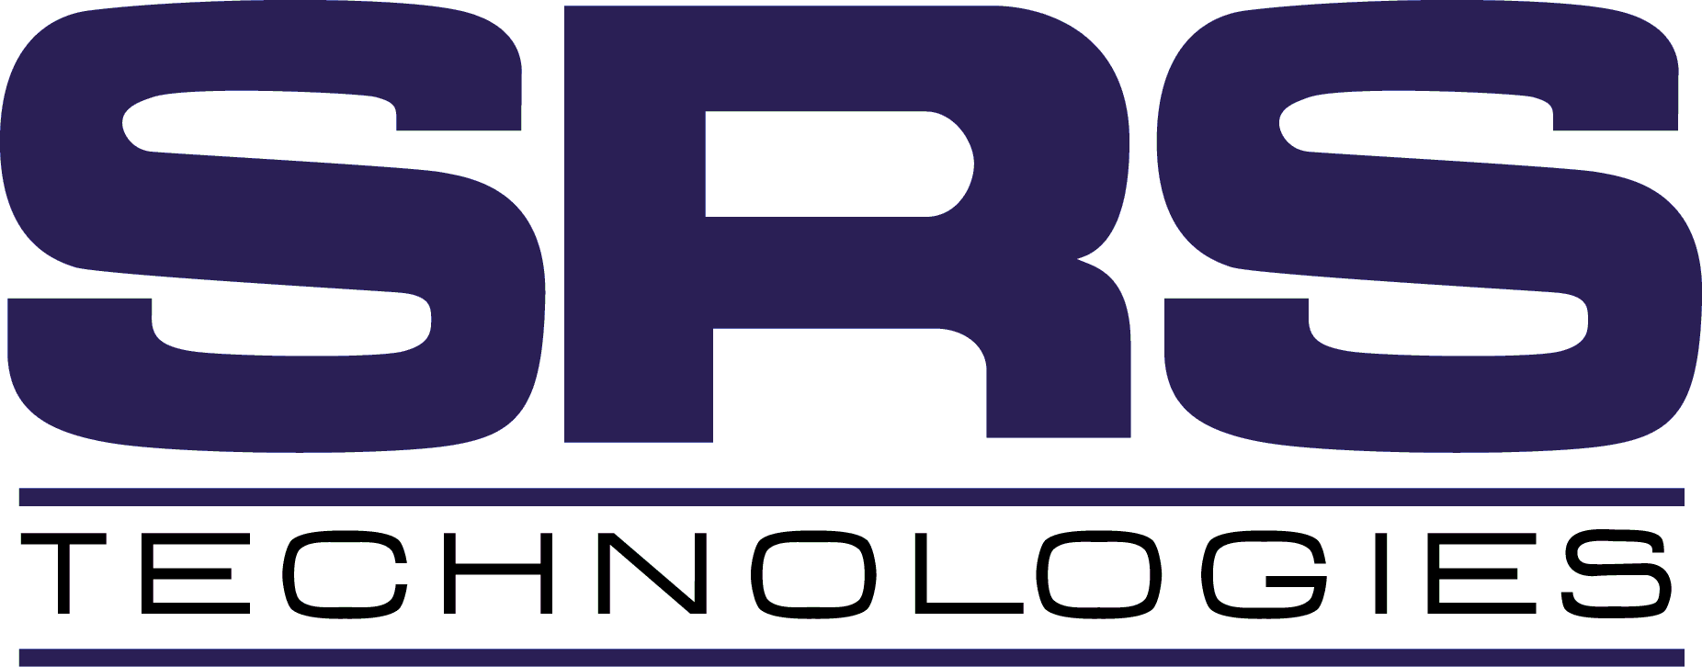
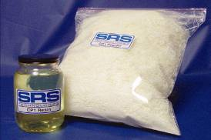
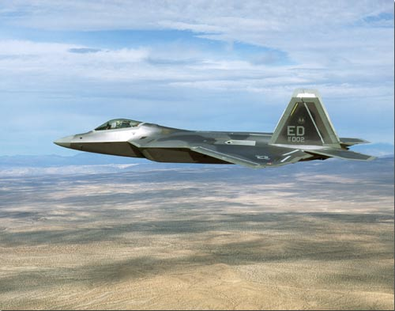
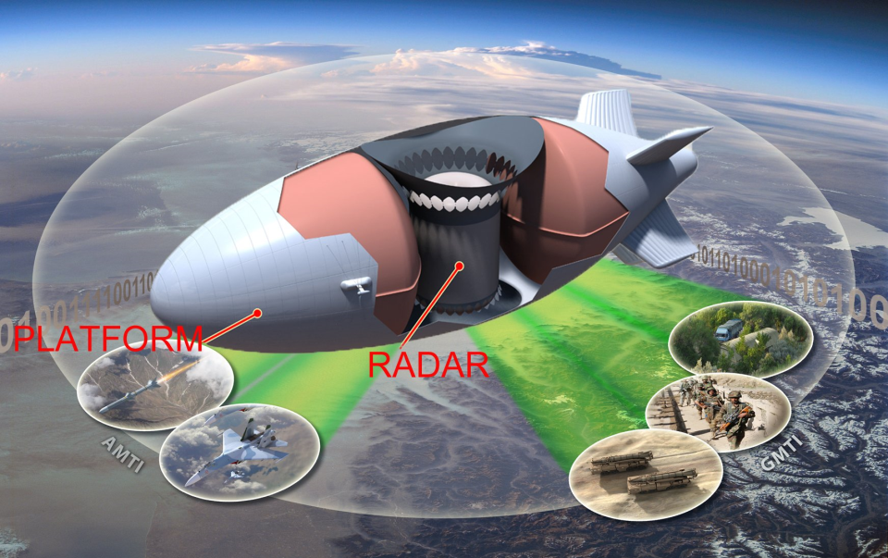

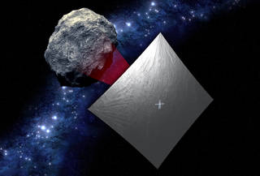
NeXolve History
1978 - SRS Technologies
  Founded in Huntsville, AL
  Small Technology Development Co.
2007 - ManTech – SRS Technologies
  SRS Technologies purchased by ManTech Corporation
  Approximately 700 employees to 12,000
  Engineering services and Cyber Security
2010 - NeXolve Corporation
  Changed to wholly owned subsidiary of ManTech Corporation –due to OCI with DARPA
2018 - NeXolve Holding Company
  NHC - formed via management buyout of NeXolve Corporation physical assets and contracts.
  Motivation – More flexibility to focus resources on advanced materials products and technology development
  Access to SBIR and SB Set aside

Slide 7
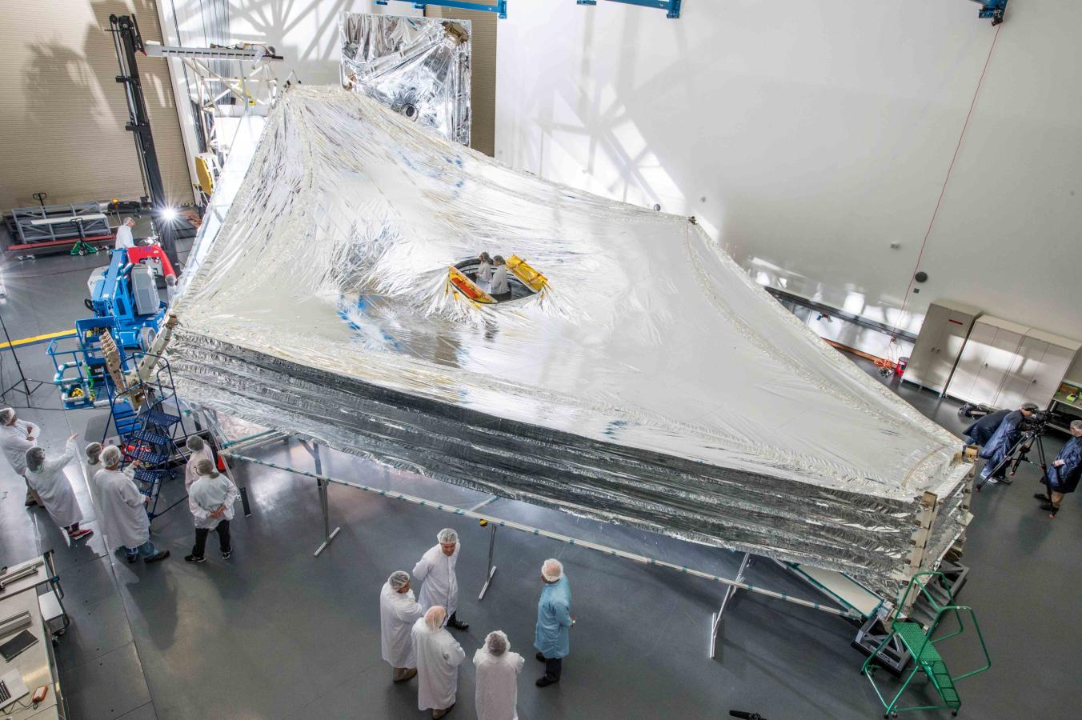
Aerospace Products
Space Products Capabilities
  Design and Modeling of light weight structures
  Polymers and materials
  Thin film products – MLI and Shields
  Metrology – laser scanners, trackers and Lidar.
  Space qualification and testing
  System Engineering and Verification
  Small spacecraft deployable systems – booms, mechanisms
JWST Sunshield Membranes – Designed and Manufactured by NeXolve
NASA - Highlights
  James Webb Space Telescope Sunshield
  LISA-T – developing unique PV system for Cubesat class missions
  NEA Scout – providing solar sail and metallic booms
NeXolve has the unique ability to design, manufacture (10k class cleanliness), and model/analyze large deployable thin film space structures

Slide 8
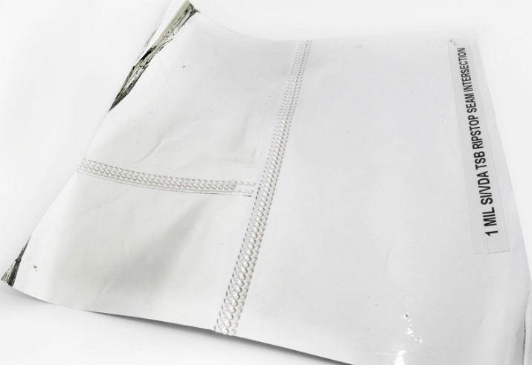
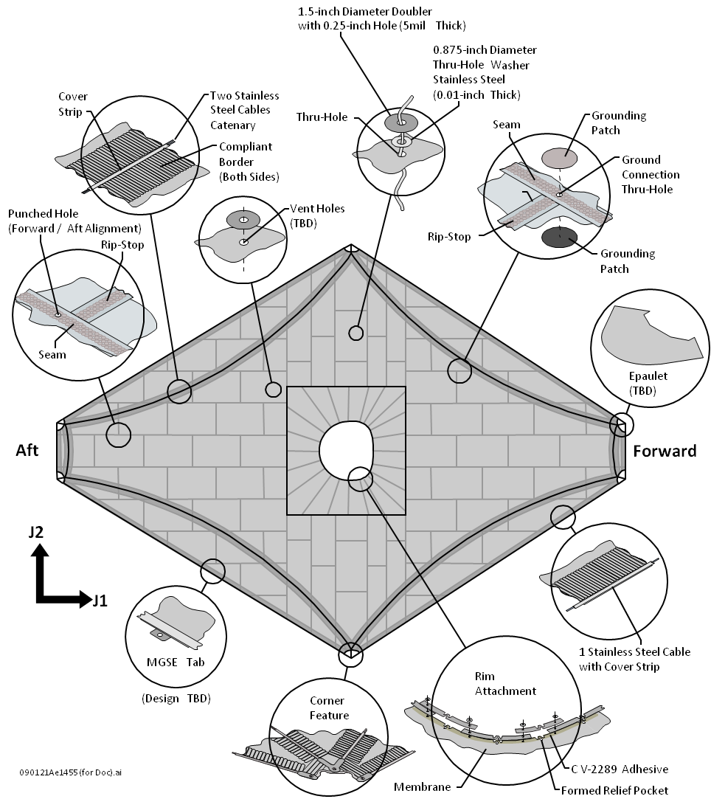
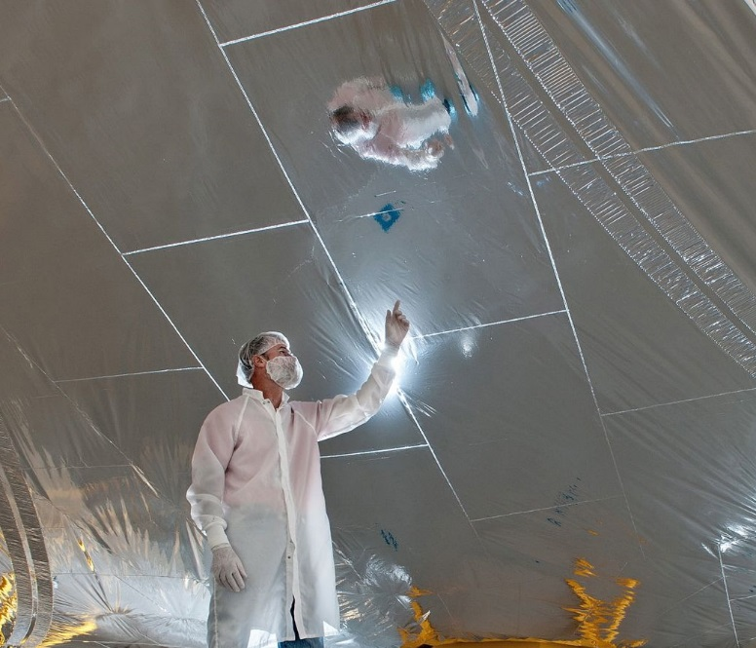
Sunshield Components
Thermal Welded Kapton Seams
Notes:
Volunteers for seam tearing, show tape sample

Slide 9
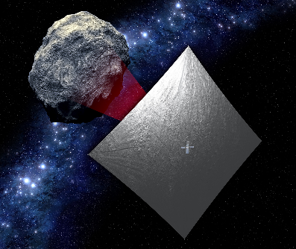
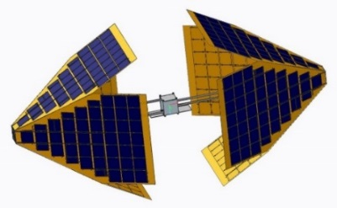
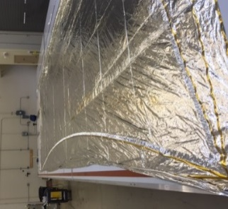
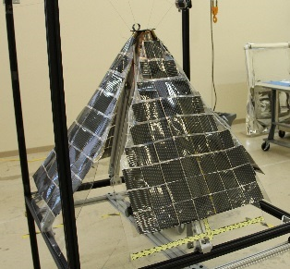
Current Applications – Small Spacecraft
Capabilities
  Design and development of light-weight deployable spacecraft systems.
  Thin film photovoltaics integrated to membrane systems.
  Large area lightweight systems such as solar sails
NanoSail-D
NEA Scout
LISA-T
NeXolve has a unique track record of developing systems for small spacecraft. Programs have included NASA-Nanosail-D, NASA NEA-Scout and LISA-T photovoltaic system.

Slide 10
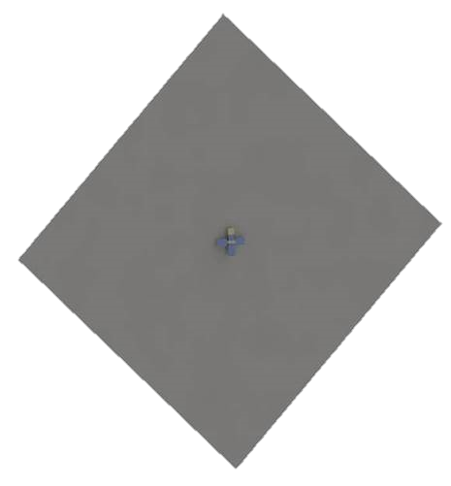
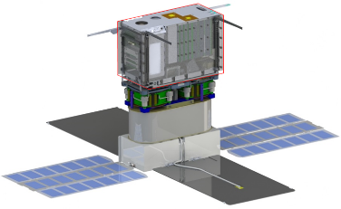
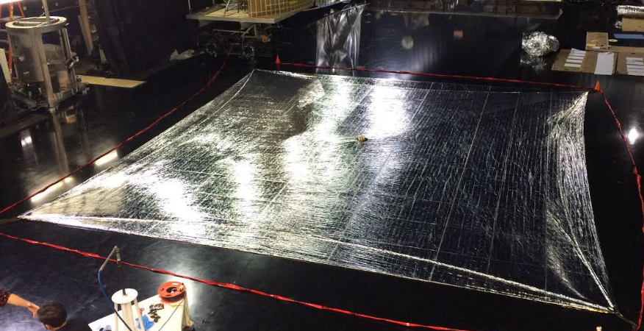
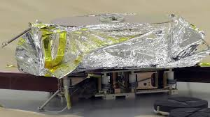
NASA – NEA Scout
NEA Scout Scope for NeXolve
  Development and delivery of Flight Solar Sail 3 micron CP1 polyimide
  Development and delivery of sail restraint device.
NeXolve Status
  MSFC EDU testing completed in fall of 2017
  Flight Hardware delivered in Feb 2018.
  NeXolve team also tasked to support on-site integration and testing at MSFC
  Launched on first SLS mission Artemis 1
NEA Scout deployed
1 – 86m² Sail
NEA Scout – prior to sail deployment
NEA Scout EDU – during deployment testing in Summer 2016

Slide 11
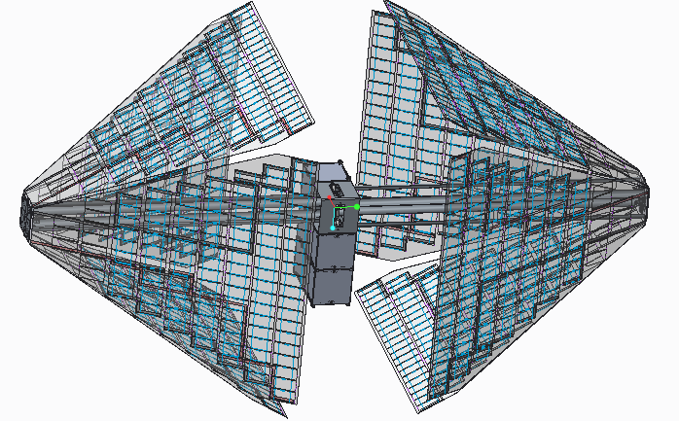
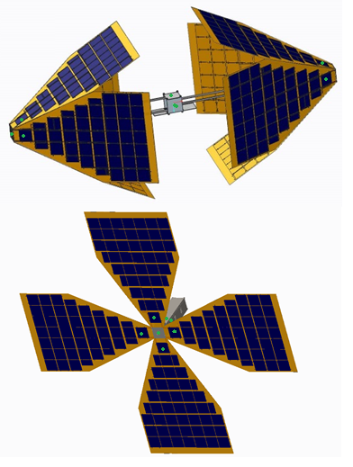
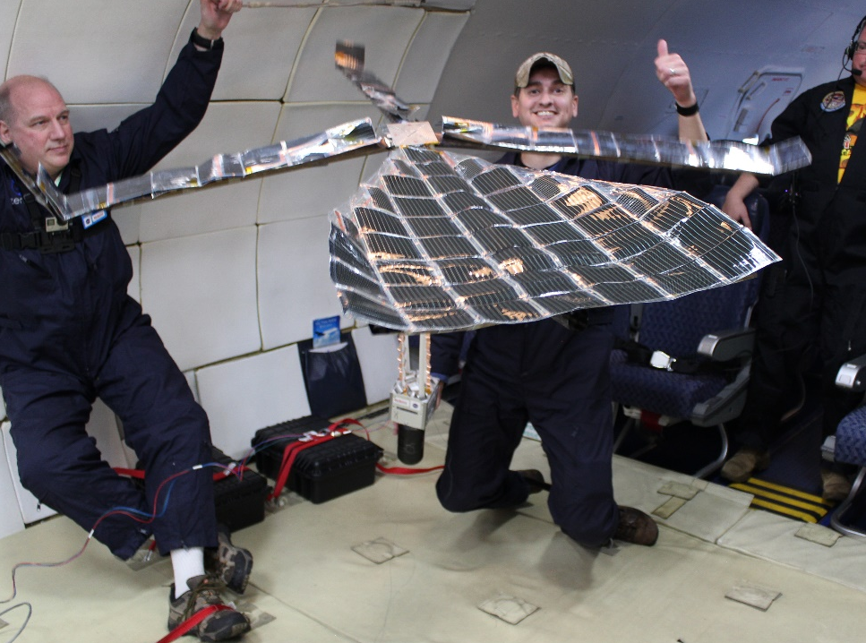
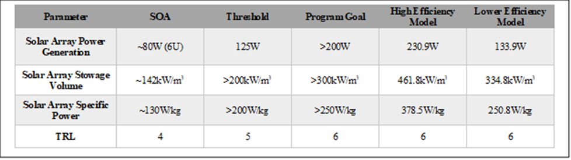
NASA – LISA-T Array System
LISA-T Scope for NeXolve
  Procurement and integration of SOA solar cells with NeXolve thin-film polyimides
  Development and design of unique deployable array
  Mechanical fabrication, testing and delivery for MSFC TRL-6 demonstration
  Development and delivery of sail restraint device.
Current Status
  TRL-6 development completed successfully.
  Demonstrated both Omni-directional array and Planar array.
  Array performance metrics exceed current SOA for small spacecraft photovoltaic arrays.
  Scheduled for Flight Demonstration on PTD 5 2024
Omnidirectional deployed
Planar deployed

Slide 12
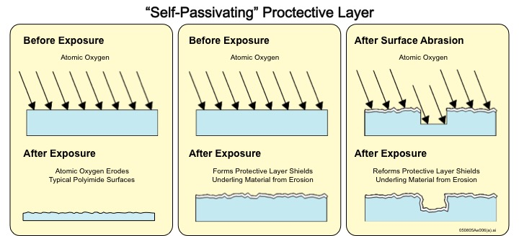
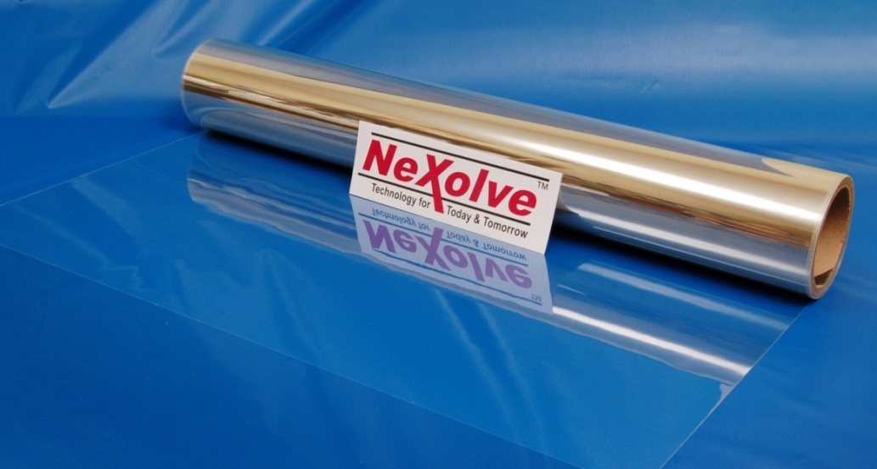
Clear and Colorless Polyimides
Base film
CP1 polyimide
CORIN polyimide -- Similar properties as CP1, with AO durability
Essar Stretch polyimide – Elastic polyimide
Film Grades
Non-conductive
Clear conductive grades available, less than 1% difference in optical transparency as compared with base grade
Dimensions
Thicknesses: 25, 12, 5, 2.5 micron, Other customer-specified thicknesses available
Lengths: 100 ft and longer
Widths: Up to 60”
Key Discriminators
Low Solar Absorptivity (Colorless)
Ultra-low gauge (0.1 mil) avail.
Low Moisture Uptake (0.5%)
Low Dielectric Constant (2.5)
CP1 Polyimide, 5 micron Thickness

Slide 13
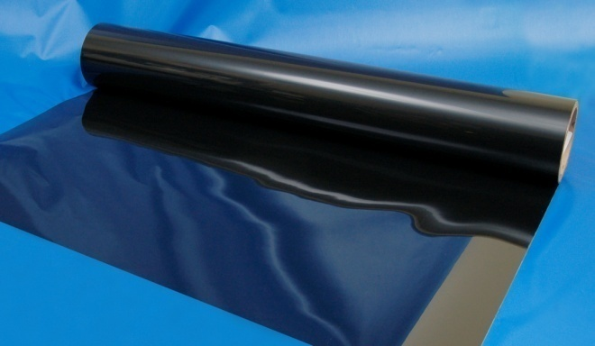
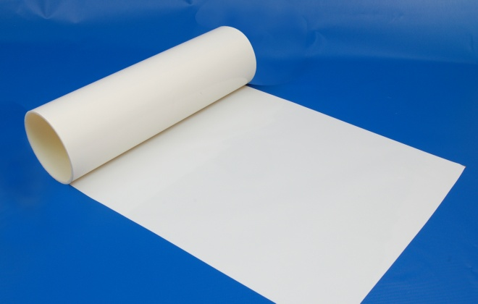

Polyimides for Thermal Control
Conductive Black and White Polyimides
  Thermalbright: α/ε=0.23
  Black CP1: α/ε=1.080
  Electrical resistivities available in white and black – 10⁴ – 10¹¹ Ω/□
  Continuous production at 1 mil thickness
  Proprietary production process ensures isotropic thermomechanical properties
  Films produced with smooth finish or textured surface for improved adhesion
  Dielectric coatings available
Continuous Production
(Conductive Black 6 Micron Shown)
Thermalbright® C – Electrically Conductive, Low α/ε
Thermalbright® N - Electrically Non-Conductive, Low α/ε
13

Slide 14
Optinox Films and Coatings
Optinox™ films and coatings are highly UV durable and exhibit excellent weathering including outstanding stability to ozone.
Optinox™ is available in rolls up to 60” wide, or in low-temperature curing liquids for coating applications. Both the film rolls and liquid coatings are available in three grades.
Three Grades:
Transparent Clear: UV cutoff at approximately 230 nm for a 2 mil film or coating
Transparent UV Blocking: UV cutoff at approximately 395 nm for a 2 mil film or coating
Reflective White: Reflective White Film
Optinox™ 200 rolls are provided either as a freestanding film, or permanently bonded to a PET backer. Additional thicknesses are also available upon request.
Optinox™ liquid curing resins are provided as a two-part curing system.

Slide 15

Dimensionally Stable Polyimides
Novastrat® History and Overview
The Novastrat® series is a patented polyimide series with controlled CTE.
Novastrat® was initially designed for interlayer dielectrics for CTE matching
All Novastrats are high temperature polyimide materials.
Photodefinable version available for patterning with either the polymer itself or traditional methods.
Vacuum coating deposition compatible.
Various methods to introduce custom surface finishes.
Novastrat 905
Novastrat 100
CP1
Property | Novastrat® 905 | Novastrat® 100 | Kapton E | CP1
*CTE (ppm/ºC) | 0.0 | 13.0 | 17.0 | 51.2
Tg (ºC) | >300 | >300 | >300 | 263
*Tensile Strength (MPa) | 281 | 208 | 262 | 100
*Youngs Modulus (GPa) | 7.5 | 6.0 | 5.5 | 2.2
Color | Yellow | Yellow | Orange | Slight Yellow
Un-coated Novastrat in DARPA MOIRE program demonstration
*Measured at RT

Slide 16





Current Applications - Optics
Optical Quality Film Manufacturing
  Optical Tolerance Surface Roughness and Thickness Variation
  Lightweight
  Uniform Properties
Decades of polymer science and film manufacturing experience have led to unique methods of material formulation and production techniques

Slide 17





Current Applications - Aerospace
Aerospace Products
  Wide Temperature/Space Durable
  Large Variety of Materials
  Custom Formulations/Properties
  Aerospace Performance
NeXolve materials are ideal for many aerospace applications and can be customized for specific functionality or operating environment.

Slide 18




Current Applications - Electronics
Electronics Grade Materials
  Low Dielectric/Moisture Uptake
  Conductive/Nonconductive
  CTE Matching
  Photodefinable
Material offerings are technology enabling and allow greater design flexibility. Tailor-made solutions for customer specific applications.

Slide 19






NeXolve Analytical Services
Overview of Analytical Services
  Contract testing and analysis of customer samples
  Routinely test samples for Aerospace, Building Material, and other industries
  Testing to ASTM standards, military standards, or customer designed specifications
  Design and perform custom experiments
  Interpret test data
  Not just another “testing house”
Testing Capabilities
  Thermal properties
  Solar/Optical properties
  Mechanical properties
  Profilometry/surface mapping
  Others
Visit nexolvematerials.com for full list of analytical services capabilities and pricing

Slide 20





Test and Analysis Facilities
Analytical Equipment
  TA Instruments Q400 EM Thermo Mechanical Analyzer
  TA Instruments Q200 Modulated DSC with RCS-90 cooling accessory
  Perkin Elmer Lambda 950 UV/Vis Spectrophotometer with transmission/reflection Spectralon integrating sphere
  Bruker Tensor 27 FTIR with transmission/reflection gold integrating sphere
  AZ Technology Temp 2000A - IR Emissometer
  X-RITE Ci6x spectrophotometer/color meter
  Instron 5569 Universal Tensile Tester with multiple environmental chambers covering -271 C (2.3K -456 F) to 315 C (600 F)
  Pneumatic adhesion tensile test instrument (PATTI)
  Polymer Standards Systems Gel Permeation Chromatography System
  Stanford Research Systems MPA 100 Melting Point Apparatus
  Brookfield LVDVE-115 Viscometers
  Ubbelohde viscometers
  Multiple Atago Abbe-type refractometers
  RF reflection inspection equipment
  Various surface/volume resistivity meters

Slide 21
Quality Control
ISO 9001:2015, AS 9100D Certifications
Aerospace programs require tight material specs & stringent manufacturing processes
  Incoming raw materials specification
  In-house testing, source supplier inspections
  Qualified and certified equipment (dedicated and shared)
  Rigorous process qualification
Examples of currently supplied products for aerospace, electronics, and medical raw materials and components
  NeXolve synthesized and formulated liquid resins used in spin-on wafer applications
  NeXolve processed and assembled thin films on DirectTV, XM Radio, and other flight hardware
  NeXolve-synthesized polyimides and NeXolve cast/cured freestanding films used in space flight on commercial satellites (>1000 m² on orbit)
  NeXolve-synthesized polyimides and silicone adhesives, NeXolve cast/cured freestanding films used in flight hardware

Slide 22

22

